Slide 1
Putting Critical appraisal into practice
Katie Reed

Slide 2
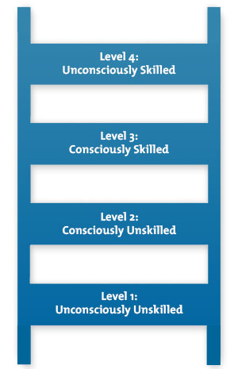
Consciously skilled or unskilled in critical appraisal ??
What are you skills now?
What were your skills before you started the MPH?
Can your skills be improved?
For distinction level dissertations, you should be critically appraising your key evidence and including this in your thesis

Slide 3
Quick revision of critical appraisal
Where an article is published, or who wrote it should not be an indication of its trustworthiness and relevance. Using critical appraisal skills and tools enables users of research evidence to reach their own judgements.
CASP approaches research in 3 steps:
1. What is the quality of the study?
The first step is to decide whether the study was unbiased by evaluating its methodological quality. Different criteria for validity of articles are used for different types of questions on: treatment, diagnosis, prognosis and economic evaluation. Depending on the validity of an article we can classify it within a scale of levels of evidence and degrees of recommendation.
2. What are the results?
If we decide that the study is valid, we can go on to look at the results. At this step we consider whether the study’s results are clinically important. For example, did the experimental group show a significantly better outcome compared with the control group? We also consider how much uncertainty there is about the results, as expressed in the form of p values, confidence intervals and sensitivity analysis.
3. Are the results useful? especially to your own context
Once you have decided that your evidence is valid and important, you need to think about how it applies to your question. It is likely, for example, that your patient or population may have different characteristics to those in the study. Critical appraisal skills provides a framework within which to consider these issues in an explicit, transparent way. (CASP website 2017)
You all have access to EBP, it is worthwhile spending an hour or two revising key areas. Remember that you can download the content as an E-Book to keep.

Slide 4
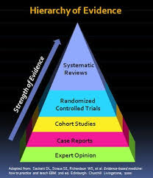
Hierarchy of evidence.
All the different levels of evidence have a part to play, but its important that the research and reader are aware of their strengths and limitations of each category.

Slide 5
But…..
How often are you appraising the literature that you cite, in a way that your reader can understand?
Always
Sometimes
Very occasionally
Never (since EBP)
Never, and I am still not sure how to go about
it ☹ ?

Slide 6
Look at the following paragraph and think which parts relate to a description of Quality? And which of Contextual relevance?
“Seven studies included in this literature review were primarily concerned with training. This included those from Jordan, Bangladesh, Myanmar, Kenya, South Africa, Nepal and Nigeria. These studies were mostly of poor quality due to a lack of baseline or follow up data and/or control groups and unclear descriptions of the interventions. These studies tended to find positive outcomes but generally just over the short term with a lack of data on the long term knowledge and behaviour of those trained. In addition, many of these interventions were on a small scale.”

Slide 7
Quality? Context relevant?
“Seven studies included in this literature review were primarily concerned with training. This included those from Jordan, Bangladesh, Myanmar, Kenya, South Africa, Nepal and Nigeria. These studies were mostly of poor quality due to a lack of baseline or follow up data and/or control groups and unclear descriptions of the interventions. These studies tended to find positive outcomes but generally just over the short term with a lack of data on the long term knowledge and behaviour of those trained. In addition, many of these interventions were on a small scale.”
This is all synthesis taken from a literature review in a distinction dissertation

Slide 8
Synthesising your critical appraisal findings
Many students find putting their ideas into academic writing a challenge at first. For this reason the University has developed a resource to help you get started.
http://www.phrasebank.manchester.ac.uk/introducing-work/
Look at
Being critical
Describing trends
Compare and contrast
Could you find some of these useful?

Slide 9
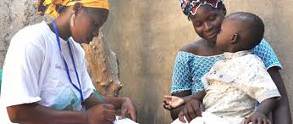
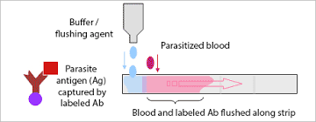
Synthesis writing exercise
You have three abstracts of papers* concerning health worker attitude to Rapid Diagnostic testing (RDT) for malaria. Assume their quality is ‘good’, this is not an exercise in critical appraisal * separate file
Write a paragraph (about 5 sentences) synthesising their findings, demonstrating your knowledge of critical appraisal and ability to synthesise in your own words
Email your finished paragraph to me and I will give you feedback.
Katie.reed@manchester.ac.uk
Title;
RDT use in SSA, health worker attitudes and practices

Slide 10
The reflect ‘what have you learned’?
About using evidence?
About your own skills?

Slide 11
Reflection; what have you learned?
About using evidence?
About your own synthesis skills?

