Slide 1
How to build on your MPH
We are very grateful to the Alumni who have kindly provided us with their own case studies. Peter, Temi, Bona’ and Daniel are all pursuing quite different career’s and we would encourage you to read all of their accounts. But as you go look for the key themes that reoccur . We have summarised some of them at the end but we would encourage to look for you own too. We would also like to add your own story in a year or two…….

Slide 2
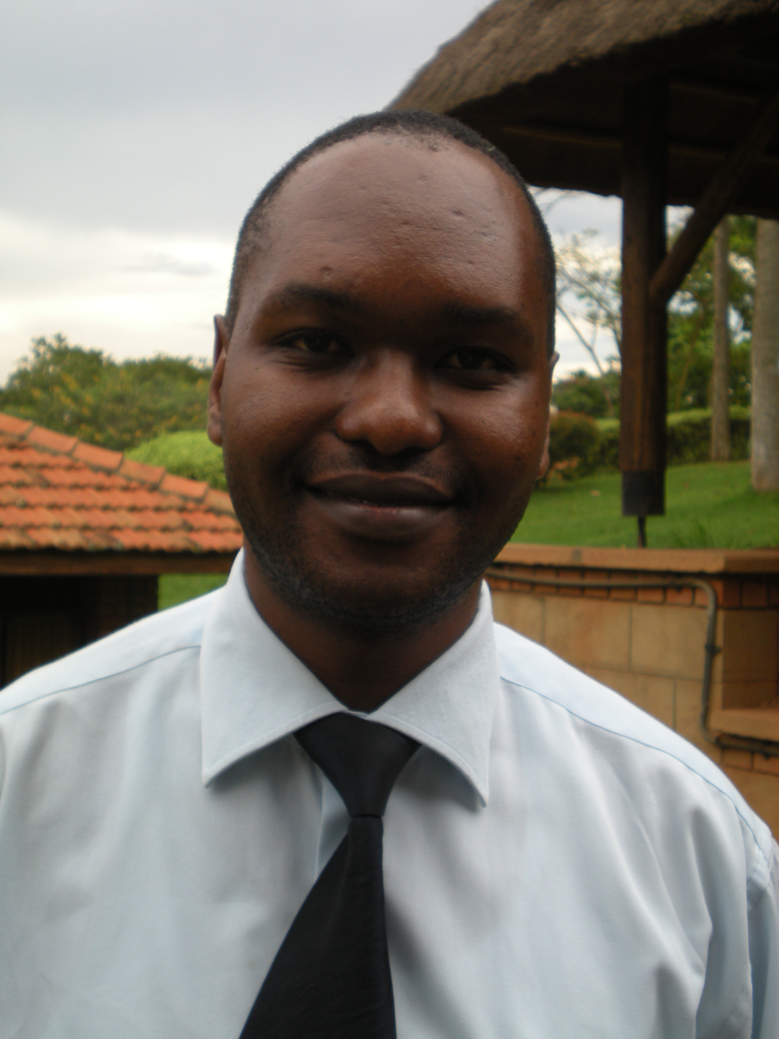
Peter Sentongo;
Career Growth since I joined the MPH Program
I joined the equity and Merit MPH program at the University of Manchester in September 2008 while working with Population services International (PSI) as a Program Coordinator, HIV/AIDS Basic and Preventive Care Program
  Basic Function : A nationwide program whose goal was to reduce morbidity and mortality among people living with HIV/AIDS due to opportunistic infections and to reduce further HIV transmission in Uganda
I was later promoted to Regional Program Coordinator HIV /Maternal and Child Health (MCH) Program Coordinator for Accessible Health Communication and Education (PACE) an Affiliate of Population services International (PSI)
  Basic function; Coordinated and supervised activities associated with provision of HIV, AIDS prevention & Treatment, promotion of maternal child health, malaria prevention and treatment, and Tuberculosis control among PHA in Eastern and Northern Uganda.

Slide 3
Career Growth since I joined the MPH Program
After completing my MPH ( even before graduation ) I was offered an opportunity at the US Centers for Disease Control and Prevention (CDC) to serve as a Public Health Specialist _HIV Prevention (January 16th, 2011 – 2013 )
  Basic function; Public health advisor on HIV/AIDS prevention to the CDC Program Branch, responsible for the design, implementation, coordination, and evaluation of CDC funded HIV prevention program activities required to implement the President’s Emergency Plan for AIDS Relief (PEPFAR) in Uganda
Following an internal restructuring , I moved on to Program Management as a Public Health Administrative Management Specialist Or Cooperative Agreements Management Specialist. (July 2013 –August 2017) at the CDC managing a grants portfolio of over $80m
Last year I was promoted to Team Lead _ Cooperative agreements Management Team at the CDC (August 2017 – to date ) supervising three Cooperative agreements specialist managing a grants portfolio of over $223M supporting Comprehensive HIV/AIDS programs in 53 districts in the republic of Uganda

Slide 4
How the MPH has Helped in my Career development
The MPH Program at the University of Manchester provided me with the right skills to complement my work experience in public health and set me on public health career growth path that I just used to dream of
  Course units like Health economics, Malaria_ HIV/AIDs _ TB management and Health systems challenges , Epidemiology and Health Promotion have been of tremendous help in enabling me to perform roles. They provided the with required foundation to analyze, understand and utilize program related data for program planning and improvement

Slide 5
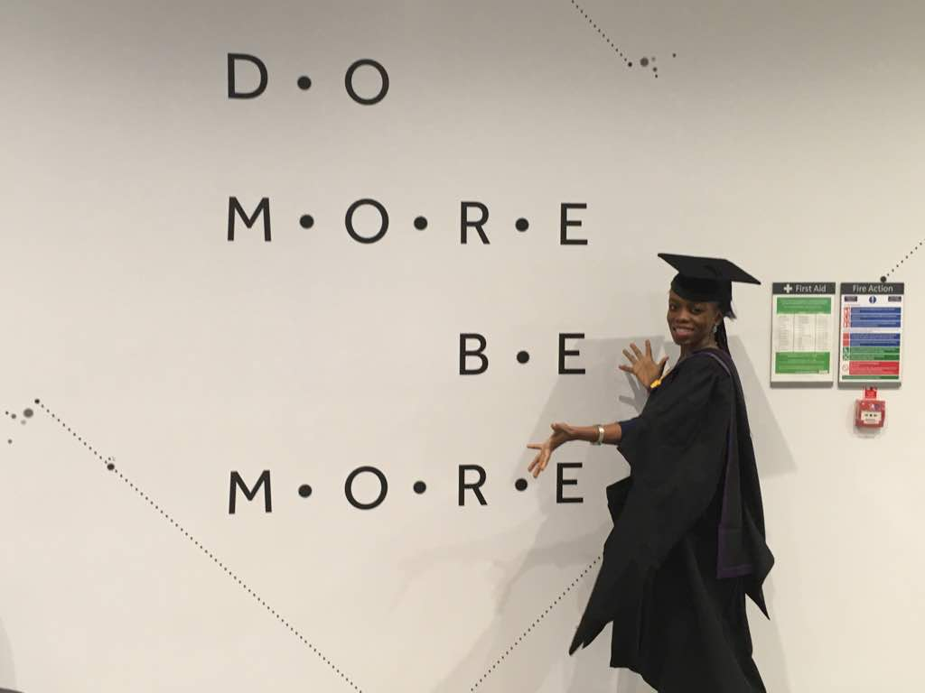
Dr Temi Omole (at her graduation 2017)

Slide 6
I started my Residency Programme in Family Medicine in Abuja in 2007. Marriage / Family came into the picture the following year...had 3 children within 5 years. Despite tremendous family support, life was really stressful and it was a struggle to keep my 'head above water' most of the time.
I got the Commonwealth Scholarship in 2011; I had just become a Senior Registrar, nursing a second baby, etc. I honestly underestimated the scale/scope of online study prior to applying for the scholarship. It was therefore no surprise that I had a really hard time combining studying for an MPH with my Residency Programme and family. I recall 'landing' a resit in my first module (PHC) and later, another one in EBP. I really appreciate the role of the Course Director... who supported and encouraged me all the way...at the same time they were firm and also gave candid advice when needed.

Slide 7
In many ways, the MPH programme helped me as a Resident Doctor; my skills in critical thinking were honed faster, my interest in research developed and I was able to carry out my dissertation with confidence and greater clarity. I completed my Residency in 2016 but stayed on as a locum physician in the hospital till the end of December 2017. Additionally, thanks to my MPH Programme, I got to better appreciate the Public Health Approach to disease prevention and health promotion. I completed my MPH programme in October 2016 and graduated in 2017.
Under the guidance of my supervisor/mentor, I went ahead to publish my work (dissertation) in a peer-reviewed journal last year. Surprisingly early this year, I was invited to review a manuscript for a similar journal. I thought to myself, "I'm just a greenhorn, can I really do this?" With a little encouragement and drawing on all I had learnt in the past years, I went ahead to review the manuscript and even got a Certificate of Acknowledgement as a Peer Reviewer.

Slide 8
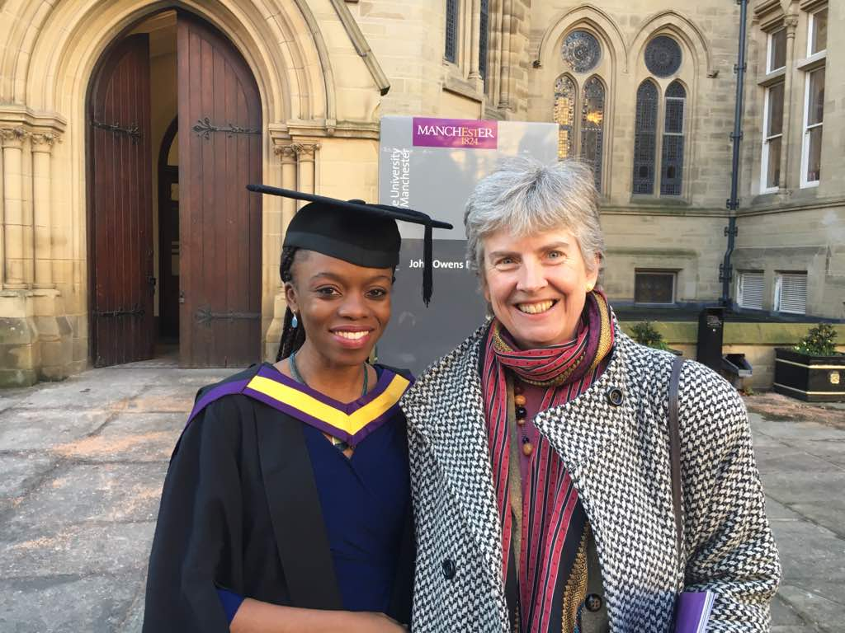
My hospital contract ended and I got into the job market which was not only competitive but there were 'limited' opportunities for getting a good job in my locality...limited, partly because I was not keen on living apart from my family on account of job relocation.
I have been in Clinical Practice for 16 years and stepping into a new field of endeavour could not have been possible without the skills acquired from my MPH and Fellowship Programme. As I mentioned earlier, I interviewed for and got employed as a Technical Advisor on Adult Anti-retroviral Treatment (Clinical Services) in an International NGO (APIN-PHI: AIDS Prevention Initiative in Nigeria - Public Health Initiatives). On this new job, alongside team members, I am to provide technical and programmatic support for high-quality HIV programme implementation and service delivery in line with recommended guidelines and global best practices. This is to be carried in many states across Nigeria. We are also to liaise with relevant government agencies (US and Nigeria) and other stakeholders. The "Programme side" of disease management and health promotion is definitely different from what I am used to (hospital-based, patient-centred care) but I feel well-equipped, having acquired competencies (during my MPH) in critical appraisal of issues, data analysis, evidence-based practice, health system challenges, communicable disease control, etc. I even recall that I learnt to use the Gantt Chart while I was doing a course on Health Promotion Theory and Methods.
'Change' can be scary but in my case, I am confident that I have what it takes to succeed.

Slide 9
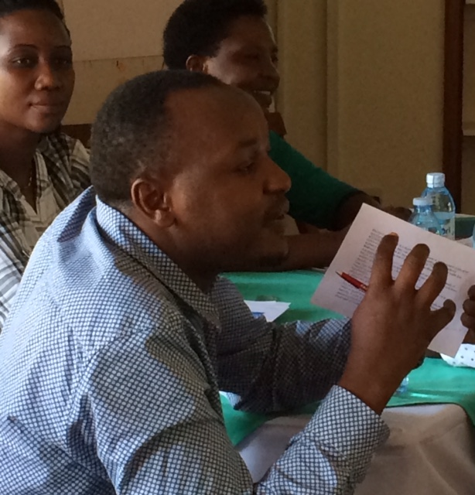
Dr Ahaisibwe Bonaventure
Repositioning my self within my organization.
I proactively availed myself to help in a couple of assignments that were not necessarily part of my core TOR including serving on working groups, assessments and report reviews.
At the next appraisal, I didn't only let my supervisor know about my additional qualification but also highlighted ways I had been able to serve the organization in a broader role with my additional training. This earned me an appointment as backup program director a role I had previously filled informally.

Slide 10




Working my network
I made sure that folks in my network are aware of my additional qualification and what additional value I was able to add in after training. I specifically targeted my mentors, referees and people I had done work with who had potential to point me to new challenges. And truly, one of them reached out when their organization was head hunting for a country director. I was fortunate to interview successfully and it the position I have held for the last two years.
I have also got a couple of consultancies and requests for talks... from folks I have kept updated on my academic progress.
Updated CV/Linkedin profile:
This is the obvious piece by don’t take it for granted. I have heard from a few people who said, " I had no idea you had an MPH" , "I was pleasantly surprised to learn that you could actually be a good fit for our assignment" ...

Slide 11
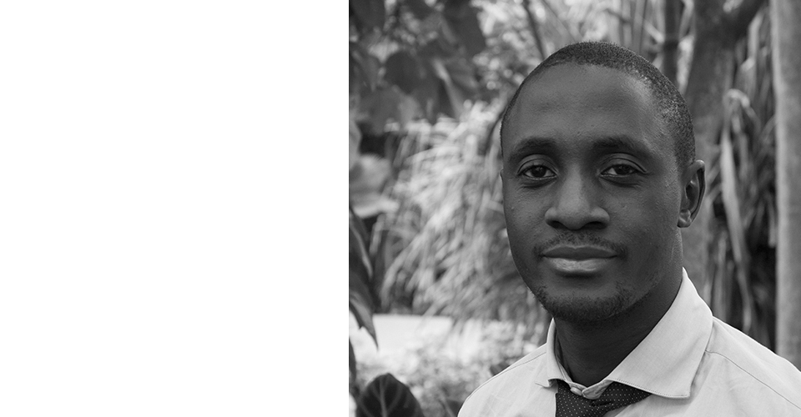
Daniel Semakula. (MPH 2010-2013.)
When I completed MPH I enrolled for a PhD which I am completing this year (2018) but I have also been involved in other public health work alongside my studies.
I have highlighted some of the work I have been involved in, where I had to apply the knowledge and skills I obtained from the MPH program. I am currently involved in a project whose main goal is to develop and evaluate learning resources to enable the public identify false claims about the effects of treatments and learn how to apply Key Concepts of evidence-informed decision-making to assess their trustworthiness and make informed health choices.
We use Key Concepts of evidence-based medicine / evidence-based practice to develop materials that are usable by members of the nonacademic public to think critically and assess the trustworthiness of claims people make about the effects (benefits and harms) of treatment.

Slide 13
4) develop a new tool for evaluating people’s ability to assess the trustworthiness of claims about the effects of treatments. Face / content validity-qualitative research methods. Item difficulty and differentiation <– Rasch analysis; Reliability <– correlation.
5) evaluate the effect of the interventions on the ability of parents and children to assess the trustworthiness of claims about the benefits and harms of treatments. This phase involved designing two randomized trials – one cluster and one individual randomized trial. – For my MPH dissertation I challenged myself to design a clinical trial protocol with anticipation that as a researcher I would have to design studies including RCTs. The experience I garnered on my MPH dissertation was helpful in the design of these RCTs. Epidemiology for the study design; Biostatistics for the analysis. Epi-Info and Epi data for data entry. Transferred StatsDirect skills to learn Stata and R programming, which I used for data management
6) Explore the factors that influenced a) the implementation (barriers and facilitators), and b) the effect of the trial + any factors relevant for scaling up the interventions. This was an implementation science process that employed both quantitative and qualitative research methods. For most of the qualitative research work I still relied on the qualitative research methodology book supplied by the university – Judith Green and Nicki Thorogood.

Slide 14
Supporting teaching and learning
Since graduation I have provided research support to 17 Masters students (MMed) in the selection/modification of their research topics, the design of their research project including data collection tools and statistical analysis – all these skills were learnt from the MPH program and only consolidated or expanded after completion. For example the StatsDirect competencies were transferred to learning Stata and R statistical analysis software which is more readily accessible in my work environment.
In addition I have supported 3 colleagues in the design of their PhD projects – One in Pharmacy, one in public health and one in Bioinformatics.
I have also supported some MPH students on the University of Manchester Equity and Merit program on some modules particularly epidemiology and biostatistics.
Lastly, I am working on a pilot project to engage people – mainly youths in the cyber space with science and research

Slide 15

Before you go to the next slide, think
What have your learned? And what could you do?
1)
2)
3)
4)

Slide 16


Our summary
Valuing your assets
Academic Skills; I.e. Research skills, evidence based practice, health systems
Report writing, analysis, teaching, supervision
Qualification; Public health Masters qualification ; necessary for PhD or promotion. Opens door for public health or other specific career paths
Professional skills; enhanced skills in writing, research , self and organisational management and enhanced clinical practice.

Slide 17
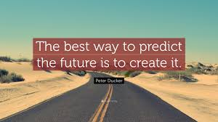

Being Active not passive,
Individuals used, applied and developed skills or learning gained from the course
People networked, marketed, and celebrated their skills.
Individuals wrote papers for publishing and applied for jobs or funding, though we see the times they were successful we know there are many disappointments along the way, but without trying you cannot be successful.
Keeping in touch , please send us your stories in the future

