Slide 1
PhD journey
Dr. Katie Reed and Raymond Tweheyo
Division of Population Health, Health Services Research and Primary Care,
The University of Manchester, UK

Slide 2
Deciding on a PhD – things to consider
Things to consider:
What will the PhD benefit you that you don’t already have (career-wise) – do you need it for your promotion? Change of career into academia? , do you need it to be able to teach?
Is it your own interest (self-drive is preferred), or is it from pressures of others or your seniors?
Have you got a mentor to tell you the merits and match between your career interests and how a PhD will make you achieve this? (advised)
Have you considered sacrifices to family (excessive dis-engagement), job-loss etc? – You need to discuss these, and find ways of making both work, or timing your start!!
The good news – a PhD is a life-long investment, no one can take it from you, and it brings you to the limelight in the science world.
The start – writing your PhD idea has many unknowns, and limited support. So you need to articulate your scientific idea concisely – to attract attention

Slide 3
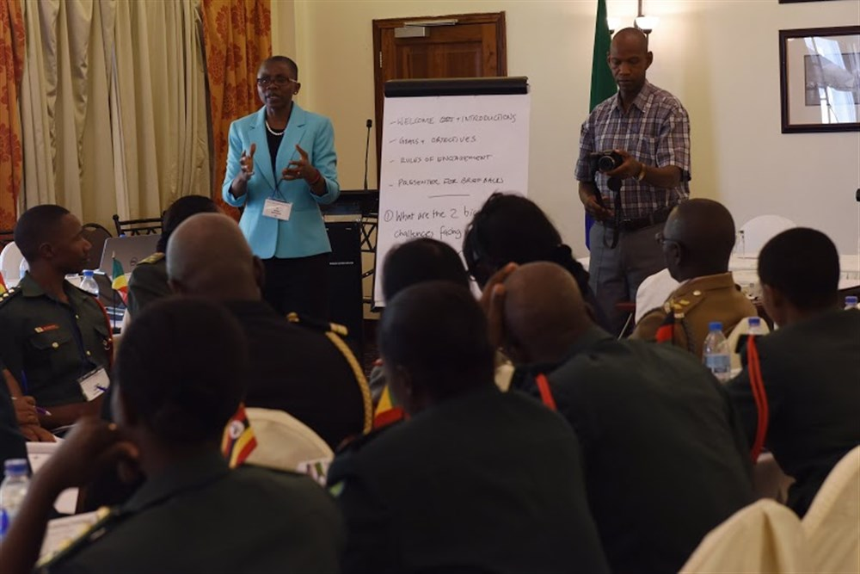
PhD tips
Things I might have done differently
Where possible, it is best to access research funding, prior to getting your PhD admission. (E.g you are named on a grant – which protects your research funding, and one of the mentors is your supervisors/ advisor).
Present your PhD idea to colleagues/ at scientific local seminar, so you receive input to refine it early – clarifies your thought process, increases your knowledge of what might be required in the PhD

Slide 4
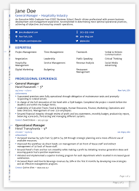
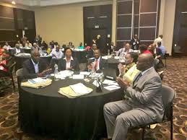
Get tips on how to write a good CV -
1) general speciality related i.e. clinical and then
2) full academic (look for examples relevant to both speciality and country (where you are applying to)
Where possible, publish work in the area that you want to commence your PhD. Attend conferences, make contacts, identify leaders in the field.

Slide 5
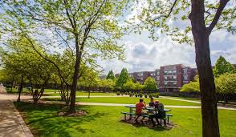
Check if there is experience of teaching in the area of your specialization? Try to be strategic (even with scholarships and donor funding)
Review doctoral team technical expertise and interest in chosen field
Consider whether to do a full time or part-time PhD, or long distance etc?

Slide 6
Consider whether to work on already available projects of the PhD supervisors, or to start from scratch
Source of funding-how professional and streamlined are funders? Do they have experience of funding PhDs?

Slide 7
A PhD is a life-long investment, no one can take it from you, but there are costs.
Weigh up the benefits and costs before you start.

